Slide 1
Software Quality Engineering
PRACTICAL SESSION NO. 2
UNIT TESTING - ISOLATION
Based on Introduction to Software Testing by University of Minnesota on Coursera and Unit tests with Mockito – Tutorial on Vogella

Slide 2
Previous Class
Challenges in software testing.
Motivation for Testing: The Zune Killer Bug.
Introducing Unit Testing.
Unit Testing with Junit 5.
Hands On: Testing Calculator Class
  Asserts
  Annotations
  Parameterized Tests

Slide 3
Agenda
Isolation in Unit Testing
Why to isolate Unit Under Test
Isolation Overview
Mockito Framework
Mocks vs Spies
Mockito Limitations
Designing for Testability

Slide 4
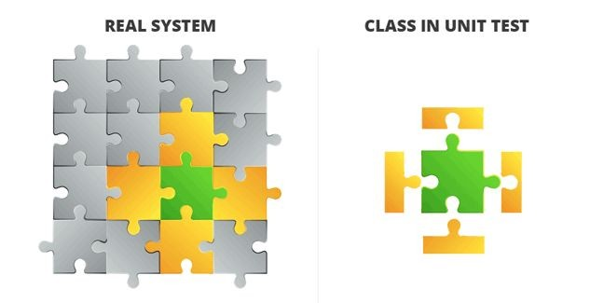
Isolation in Unit Testing
Unit tests must operate independently, free from external dependencies or environment-specific settings.
Notes:
When creating unit tests we want to make sure that we are able to test the functionality of a single class independently from its external dependencies.

Slide 5
Characteristics of Isolated Unit Tests
No External Dependencies:
Avoid reliance on databases, network resources, or external systems.
Use mocks or stubs to simulate interactions with external components.
Focused Scope:
Concentrate on testing a single class or a small unit of functionality.
Ensure each test is narrowly targeted and does not overlap with integration or functional tests.
Notes:
Therefore, we can define an isolated unit test as one that focuses solely on a single class, which has no external dependencies, such as databases, network resources, and external services. To accomplish this we will leverage a mocking mechanism that simulates the interactions with the external components and creates an artificial sandbox that allows to test all of the inner functionality of the class under test.

Slide 6
Motivation Behind Isolation
Simplifying Debugging and Maintenance:
  Easier to pinpoint the source of an issue in an isolated environment.
  Changes in one part of the code have no impact on isolated units.
  Faster execution of unit tests.
Revealing Unnecessary Dependencies:
  Isolation highlights tight coupling between classes.
  Helps identify and remove dependencies that aren't essential.
Notes:
Why is it important to focus on isolation? Which we can expand into why is it important to test the functionality of a single class isolated from the other classes in the system?
1) For debugging and maintenance, it’s easier to find bugs and flaws in the class if we don’t have to look in all the dependencies around the class, and all the side effects caused by those dependencies.
2) Sometimes, some dependencies are not actually required, and could be abstracted out for cleaner code.
For example:
if we have an authentication class that is tightly coupled to a database, like if the class makes direct calls to a library API.
1. If a test fails, it’s unclear whether it’s because of the authentication logic test or the database library.
2. While unit testing, if it’s hard to separate the database library invocation from the main class under test, it means the library class is tightly coupled to the authentication class.
This api could be abstracted by an interface/abstract class.
Separation -> Code becomes clear -> Allows for easier maintenance and it becomes easier to test the class.

Slide 7
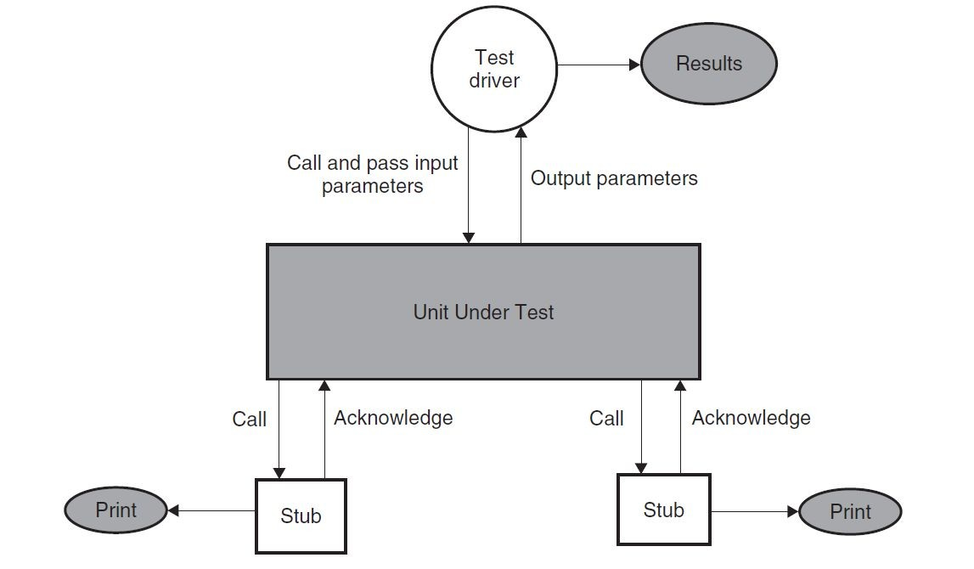
Isolation Example Overview
(JUnit)
(Class)
(Dummy server)
(Fake DB)
Notes:
As an overview, you can look at this picture that shows the typical methodology for isolating in unit testing.
You will have the:
Test driver, which are test cases and the framework responsible for setting, running the tests, and reporting the results.
The Class under test, which want to isolate
And a type of mocking entity that will isolate the class from its dependencies, in this case we are talking about stubs.

Slide 8
Isolation Example Overview
(JUnit)
(Class)
(Dummy server)
(Fake DB)
Notes:
As an overview, you can look at this picture that shows the typical methodology for isolating in unit testing.
You will have the:
Test driver, which are test cases and the framework responsible for setting, running the tests, and reporting the results.
The Class under test, which want to isolate
And a type of mocking entity that will isolate the class from its dependencies, in this case we are talking about stubs.

Slide 9

Mockito
Mocking framework for Java.
Creates substitutes of real objects for testing purposes.
Facilitates testing of classes with external dependencies.
Isolates the Unit Under Test from its surroundings.
Notes:
In Java, while as Test Driver we learned last class about JUnit5, to create mocks and isolate the class under test from its dependencies, there a very robust tool called Mockito.

Slide 10
Mockito - Set Up
@ExtendWith(MockitoExtension.class)
public class MockitoAnnotationUnitTest {
...
}
Alternatively:
@BeforeEach
public void init() {
MockitoAnnotations.openMocks(this);
}
Notes:
To set it up, besides importing the package, you will have to, first, to extend Junit5 with the MockitoExtension plugin.
Then, as we discussed last class about the annotations to set up the tests, in the method that executes before each method, we run the openMocks function to initialize all the Mocks and Spies that we define in the attributes.
First, what is a Mock, and how do we set it up?...

Slide 11
Recall:
Four parts to a test (AAA Pattern)
Setup (Arrange)
Invocation (Action)
Assessment (Assertion)
Teardown
Notes:
First, recall the four parts involved in the creation of a unit test:
Arrange and setup the required environment for testing,
Then we invoke the methods we want to test
Then, we evaluate and assert the successfulness of the method execution
Last, we close connection to required external dependencies, and delete used objects, so that the next test is independent form the last one.

Slide 12
Mock
A mock is an object that mimics the behavior of a real object, in a controlled way.
Create
Mock Object
Setup (Arrange)
Invoke (Action)
Assessment (Assertion)
Teardown
Initialize
Class Under Test
Calls
Uses
Verify
Notes:
A Mock is one of the available structure to isolate the class under test. It acts as fake object that mimics the behavor of a real object.
So, following the AAA pattern, when we setup the tests, we actually create Mock objects for the dependencies required by the Class Under Test.
Then, when we invoke the functions we are testing, the Class Under Test will use the mocked objects instead of the real ones.
And the rest is the same as before.

Slide 13
Mockito - @Mock
@Mock
List<String> mockedList;
@Test
public void whenUseMockAnnotation_thenMockIsInjected() {
mockedList.add("one");
Mockito.verify(mockedList).add("one");
assertEquals(0, mockedList.size());
Mockito.when(mockedList.size()).thenReturn(100);
assertEquals(100, mockedList.size());
}
Notes:
To create mocks, we simply initialize the structure as an attribute in the Test Class annotated with the Mock annotation.\
Then, when the setup is executed it will instantiate the mockedList.
Then inside the test, you can verify how does it work:
We add one to the list.
We used the Verify functionality from the mocked list to check if the function “add(one)” was called,
This function supports receiving another parameter which represents the number of times we expect it to be called
It will fail the test if the function is not called
Then, we assert if the size of the list changed, which it didn’t because the list is not a real object and it will return the default vault for integer (0)
Then, we change the default value for integer for the function size(), to return 100
So when we test it now, it will return 100
That’s how we control the behaviour of the mocked objects

Slide 14
Spy
A spy wraps a real object used by the class under test.
It records interactions with the object, allowing verification of method calls and arguments.
Create
Spy Object
Setup (Arrange)
Invoke (Action)
Assessment (Assertion)
Teardown
Initialize
Class Under Test
Spied class
Calls
Uses
Verify
Notes:
Now, the spy operates a little different than a Mock. Instead of creating a Mocked object, that is not real, it wraps itself under a real instantiated object.
It is usually used for Classes that we know for a fact that are robust and don’t have faults, or partially implemented classes.
They provide the real object, the same functionality of the mocked object, where we can observe the behavior and also update the returned value of a specific method.

Slide 15
Mockito - @Spy
@Spy
List<String> spiedList = new ArrayList<String>();
@Test
public void whenUseSpyAnnotation_thenSpyIsInjectedCorrectly() {
spiedList.add("one");
spiedList.add("two");
Mockito.verify(spiedList).add("one");
Mockito.verify(spiedList).add("two");
assertEquals(2, spiedList.size());
Mockito.doReturn(100).when(spiedList).size();
assertEquals(100, spiedList.size());
}
Notes:
As you can see here in this example, we add the @Spy annotation to an instantiated class. This could also have been done inside the test or the setup, with the invocation of the static function spy().
In this test we observe the following:
We add two items to the list
We verify that those items were called
We assert whether the size of the list increased, which we expect to have happened
We then change the behavior of the size method of the spied object
We assert whether the returned value is now 100

Slide 16
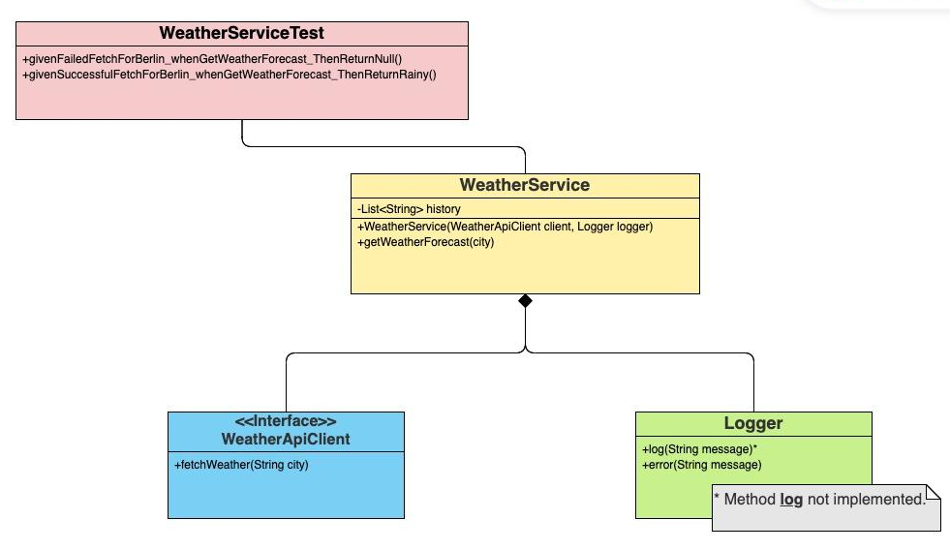
Demo - Junit5 + Mockito
Notes:
-> Check README for Demo1

Slide 17
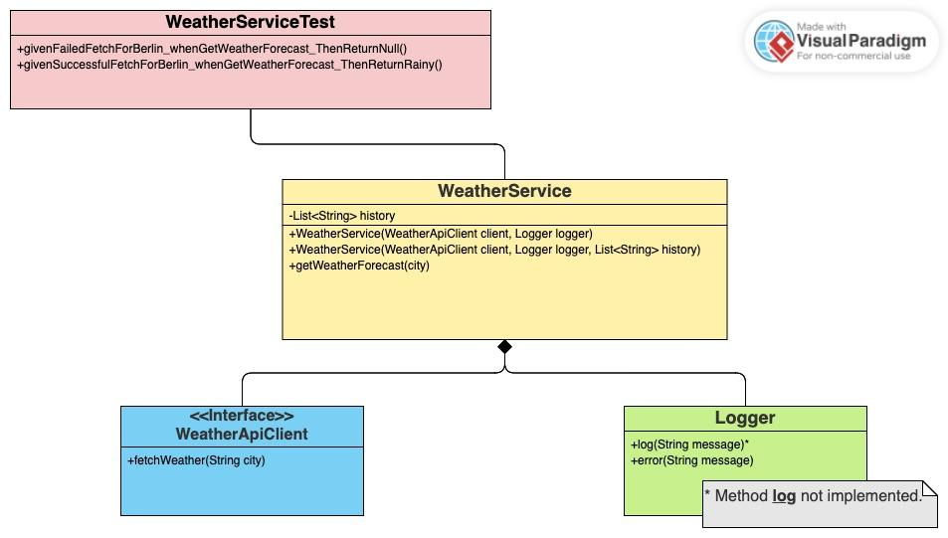
Demo2 - Junit5 + Mockito
Notes:
-Check READEME for demo2
- This one receives the List<String> history as a parameter in the constructor.

Slide 18
Testing Recipe (AAA Pattern)
Arrange
    Set up: Instantiate necessary classes.
    Stubbing: Define behaviours for mocks/spies.
Act
    Act: Call the method under test.
Assert
    Verify: Verify the interactions.
    Assertions: Assert outputs.
Notes:
So, as we observed in the demo, the way to setup a test following the AAA pattern, but now with mocks, is to include the stubbing operations in the Arrange stage.

Slide 19
When to use Mocks vs Spies?
Mocks are ideal when you don't have an implementation, need complete control over the behavior of a dependency, or when the real implementation is impractical for testing.
Spies are suitable when you have a working implementation that you want to use, but you also need to monitor or verify certain aspects of its behavior.
Notes:
An important question is when do we actually use Mocks version using Spies.
Mocks should be used when we don’t have the actual implementation of the dependent classes, or when the real implementation of the dependency is impractical to use, for example, if it uses a database that requires a strenuous setup resources and time.
Spies, on the other hand, as they use the real object, they are better used when we have a working implementation of the dependency we want to use, or whether the tested object is natively bug free, like the libraries that come with the language, which we are confident in their capabilities.

Slide 20
Mockito Limitations
It can’t mock private and static methods.
It can’t mock private fields.
It can’t mock constructors.
It can’t mock final methods and classes.
Notes:
Although Mockito is an effective tool for Unit testing, it presents some limitations that need to be addressed.
First, in terms of methods, it doesn’t mock private and static method.
Then, in terms of fields, it doesn’t mock private fields inside the class under test.
It doesn’t mock constructors.
And can’t mock final methods and final classes.

Slide 21
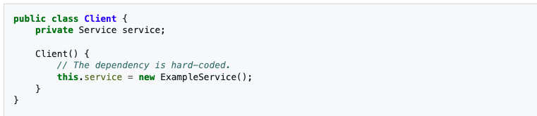
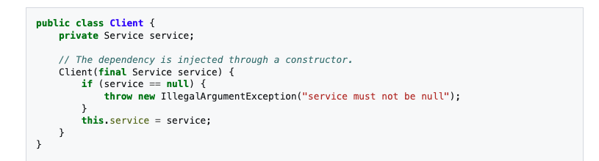
Designing for Testability
Dependency Injection
Notes:
To address these issues, the only solution, besides using other extensions, are to design the code to be test friendly.
For example, use constructors that allow for the private classes that will be mocked to be used instead of instantiating inside the constructor.
Instead of using private methods, rely on public and protected methods, to give more access to more behavior inside the class.
Use interfaces and abstract classes to abstract the access to other classes and libraries, to increate the flexibility when using Mockito.

Slide 22
Designing for Testability
Use constructors for injecting spies/mocks:
  Use constructors or setters to inject dependencies.
  Benefit: Simplifies mocking as dependencies can be easily replaced with mock objects.
Favor Public and Protected Methods:
  Avoid private methods; use public or protected methods where possible.
  Benefit: Facilitates easier mocking and testing of class behaviors.
Use Interfaces and Abstract Classes:
  Design with interfaces or abstract classes that can be easily mocked.
  Benefit: Increases flexibility and allows Mockito to create dynamic proxies.
Notes:
To address these issues, the only solution, besides using other extensions, are to design the code to be test friendly.
For example, use constructors that allow for the private classes that will be mocked to be used instead of instantiating inside the constructor.
Instead of using private methods, rely on public and protected methods, to give more access to more behavior inside the class.
Use interfaces and abstract classes to abstract the access to other classes and libraries, to increate the flexibility when using Mockito.

Slide 23
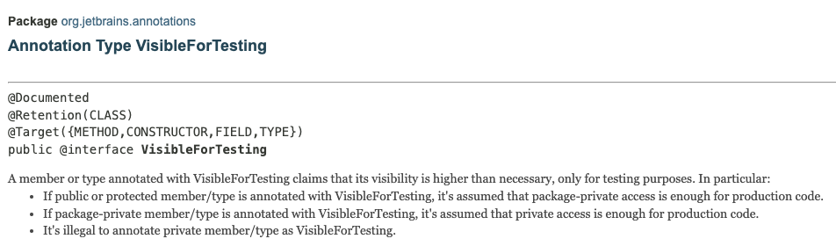
@VisibleForTesting
https://javadoc.io/doc/org.jetbrains/annotations/22.0.0/org/jetbrains/annotations/VisibleForTesting.html
Notes:
This class should be used when using a second constructor that receives all the fields that we want to mock as parameters. By annotating the second constructor with this annotation, it marks this constructor only for test use. It will raise a warning when the constructor is used in production outside of testing scope.

